Slide 1

Aadhar based analysis using Pyspark Presented by: Rahul Parmar (AU2044001) Pathik Patel (AU2044010) (MTech)

Slide 2
Background
What is Aadhaar
Aadhaar number is a 12-digit random number issued by the UIDAI (“Authority”) to the residents of India after satisfying the verification process laid down by the Authority. Any individual, irrespective of age and gender, who is a resident of India, may voluntarily enroll to obtain Aadhaar number. Person willing to enroll has to provide minimal demographic and biometric information during the enrolment process which is totally free of cost. An individual needs to enroll for Aadhaar only once and after de-duplication only one Aadhaar shall be generated, as the uniqueness is achieved through the process of demographic and biometric de-duplication

Slide 3
Overview
Analyzing a dataset of Aadhaar - a unique identity issued to all resident Indians using Pyspark
Dataset size & source : 44 MB (12 columns & 440819 rows, March 2018, Kaggle)
Dataset Attributes: Registrar, Enrolment Agency, State, District, Sub District, Pin Code, Gender, Age, Aadhaar Generated, Enrolment Rejected, Residents Providing Email, Residents Providing Mobile Number
Dependencies used:
Spark
Python
Matplotlib
Pandas library

Slide 4
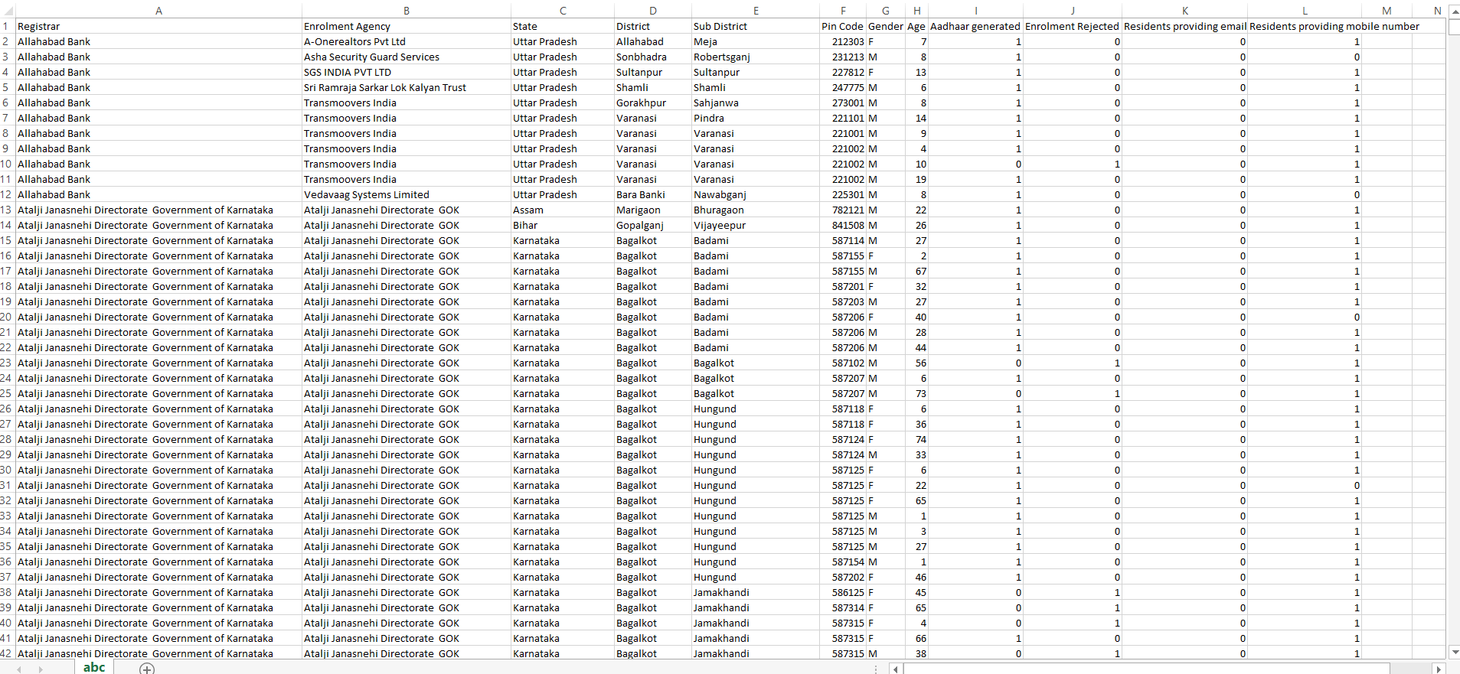
Screenshot of Dataset

Slide 5
Dataset in brief
Registrar : A registration office or bank which official registered with UIDAI
Enrolment Agency: A agency which done all enrolment work of citizen and engaged with registrar
State: A state information where adhaar generation done
District: Which is sub-sequent of state / District wise data generation
Sub District: Which is sub-sequent of district/ sub-District wise data generation
Pin Code: Sub-District pin code
Gender: Aadhaar customer gender
Age: Aadhaar customer age
Aadhaar Generated: Aadhaar generated or not / 0 - not generated , 1 - Aadhaar generated
Enrolment Rejected: Enrolment rejected or not / 0 - not rejected, 1 - enrolment rejected
Residents Providing Email: Aadhaar customer email-id
Residents Providing Mobile Number: Aadhaar customer mobile no.

Slide 6
Data Cleaning / pre-processing
Approach:
We get adhaar data and upload CSV file in PySpark module link with SQL context.
After we have data in our data frame clean data, drop null values from data frame and make it more clear towards getting insight form them.
And remove some outlier and normalize some values of data frame in the part of data pre-processing.
Other than that we change some of the column’s data type and make it more simple.
And than after change spark data frame to pandas readable data frame for visualization.
pd_df = df.toPandas()

Slide 7
Observations in project
Counting age group as per average based on gender
Which gender has more entries
How many aadhar applicants are based on gender also in percentage
Percentage of overall applicants per state
Percentage of overall that were approved
Percentage of overall applicants per aadhar card generation per state
Percentage of overall applicants per aadhar card rejection per state
Percentage of mobile registered with aadhar card
Which state have maximum number of entries

Slide 8
Observations(2)
Percentage of email registered with aadhar card
Description of aadhar accepted and rejected
Description of aadhar generation
Total numbers of registrars and its description
Which registrar has generated maximum number of aadhar

Slide 9
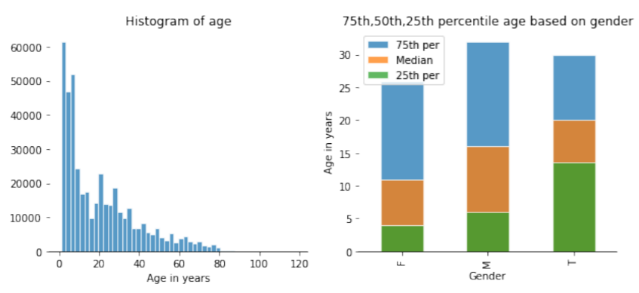
1. Counting age group as per average based on gender
In the first figure Histogram of different age groups is been plotted which clearly shows data is on high up to age of 15 and gradually starts decreasing
The second graph shows percentile count of different gender age wise. It shows data of male is higher and its average lies 10 to 20.

Slide 10
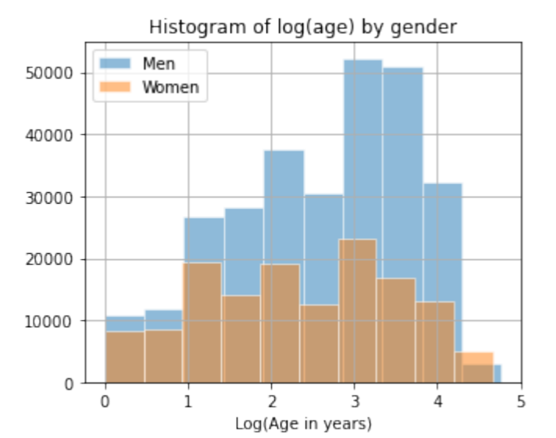
2. Which gender has more entries
This graph shows histogram between genders with log(age). Clearly data of Men are excessive.

Slide 11
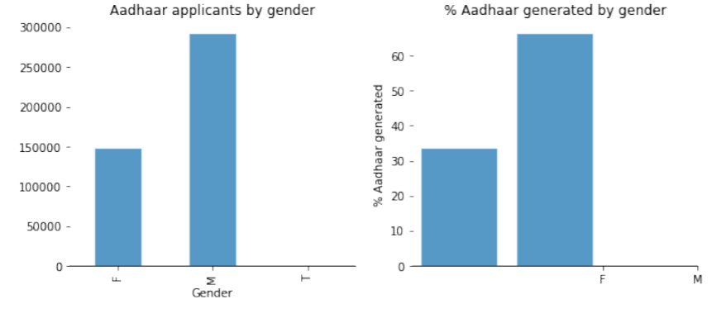
3. How many aadhar applicants are based on gender also in percentage
In this both figure shows aadhar applicants by gender & %age generated by gender both are lofty.
The data clearly shows male Aadhar applicant is almost double than female

Slide 12
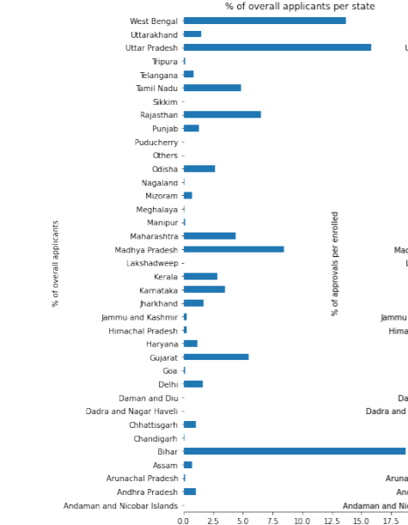
4. Percentage of overall applicants per state
As per graph its all about how many Aadhaar applicant per state belonging.
The state of Bihar had highest percentage of applicants almost 17.5 % followed by Uttar Pradesh, West Bengal and so on.
Sikkim, Puducherry were least followed by various states.

Slide 13
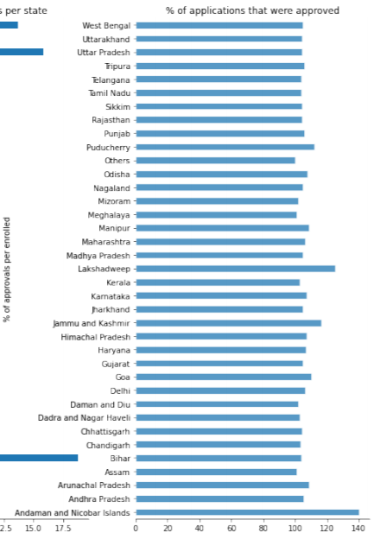
5. Percentage of overall that were approved
In this graph percentage of applicants that were approved were highest for Andaman and Nicobar Islands Almost followed by Lakshadweep, Puducherry and so on.

Slide 14
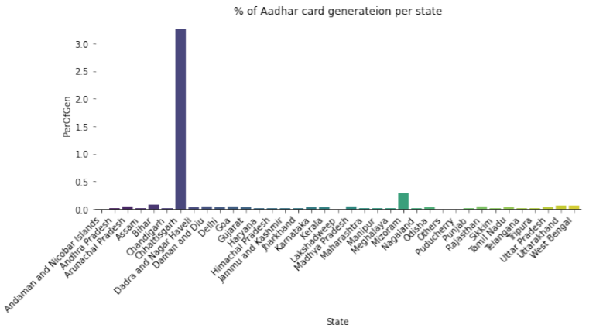
6. Percentage of overall applicants per aadhar card generation per state
In this graph mention percentage of aadhaar card generation per state Chhattisgarh recorded highest percentage of Aadhar generation per state followed by Mizoram.
Andaman and Nicobar Islands an many other states recorded the least.

Slide 15
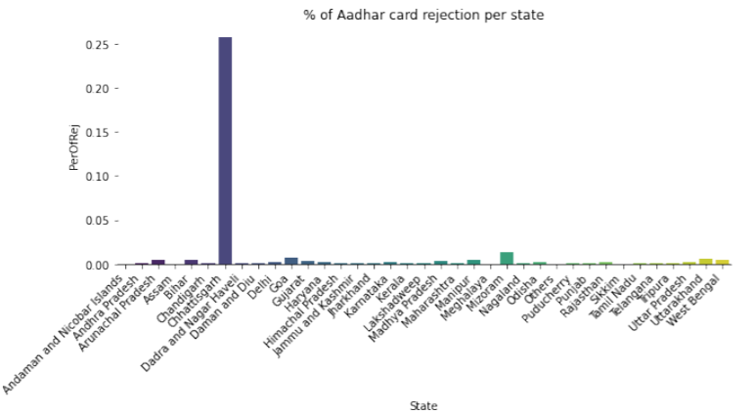
7. Percentage of overall applicants per aadhar card rejection per state
Again the rejection per state was at peak for state of Chhattisgarh followed by Mizoram.

Slide 16
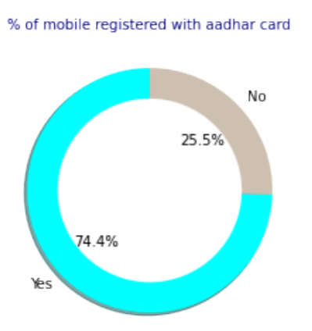
8. Percentage of mobile registered with aadhar card
In the data around 74.4% of mobile were registered with aadhar card contrary to 25.5% didn’t registered it.

Slide 17
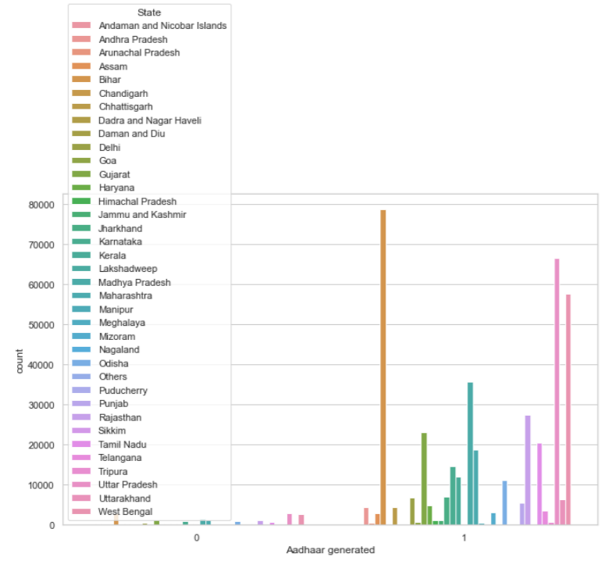
9. Which state have maximum number of entries
This figure of state wise distribution of aadhar generated entries shows clearly again Bihar was at the peak.

Slide 18
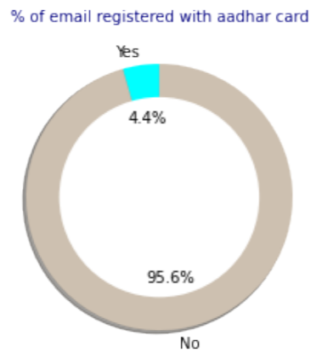
10. Percentage of email registered with aadhar card
In the data around 95.6% of email were not registered with aadhar card contrary to 4.4% registered it.

Slide 19
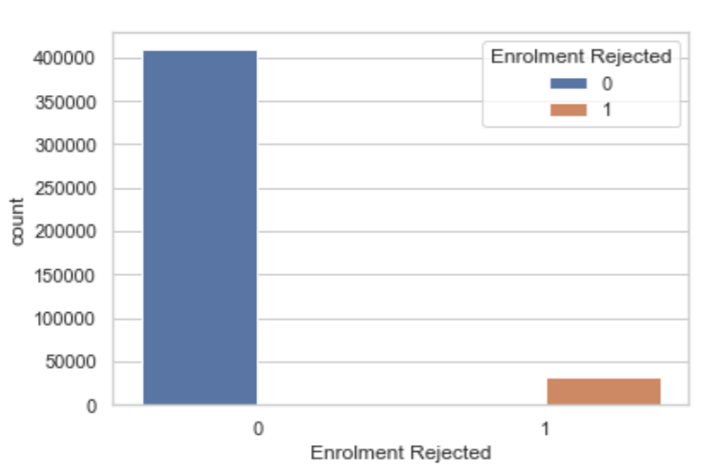
11. Description of aadhar accepted and rejected
In this figure Enrolment Rejected 0 means aadhar generated where as Enrolment Rejected 1 shows aadhar rejected.

Slide 20
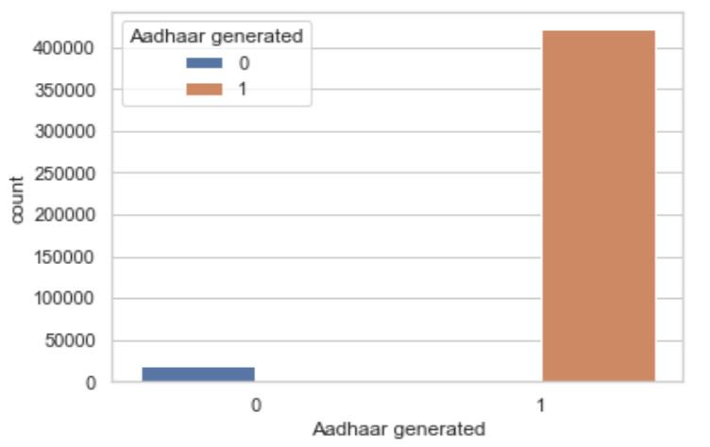
12. Description of aadhar generation
In this figure Enrolment Rejected 1 means aadhar generated where as Enrolment Registered 0 shows declined count

Slide 21
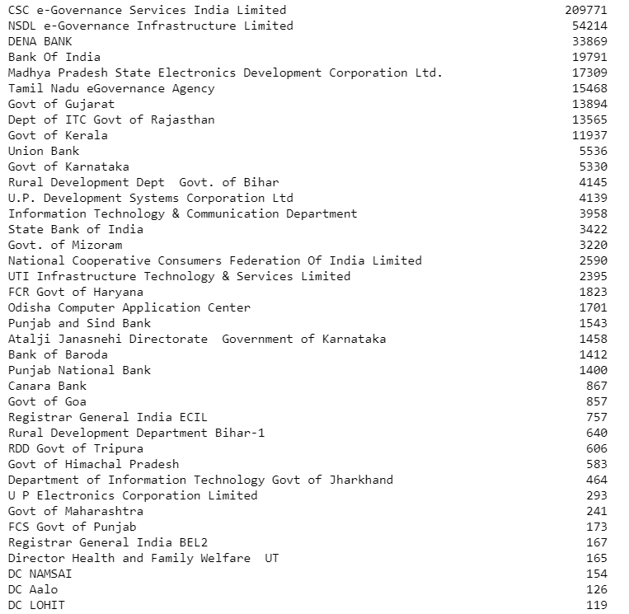
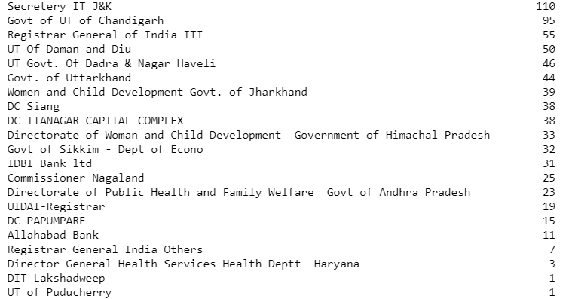
13. Total numbers of registrars and its description
This figure shows the list of registrars from where persons have registered. CSC e-Governance Services India Limited had done maximum registration of 209771 entries where as UT of Puducherry had done only 1 registration.

Slide 22
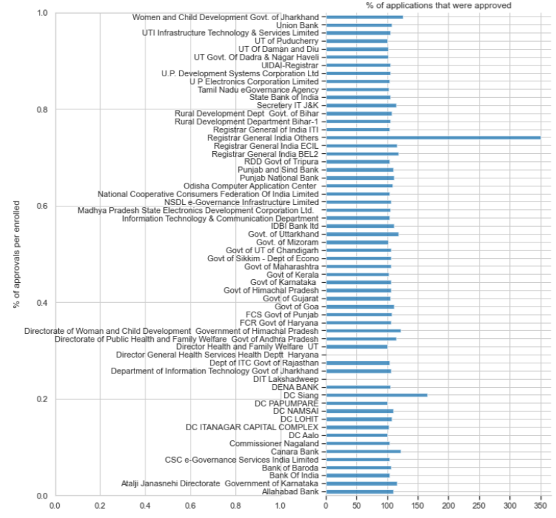
14. Which registrar has generated maximum number of aadhar
In this figure Registrar General India Others had highest percentage of applications that were approved

Slide 23
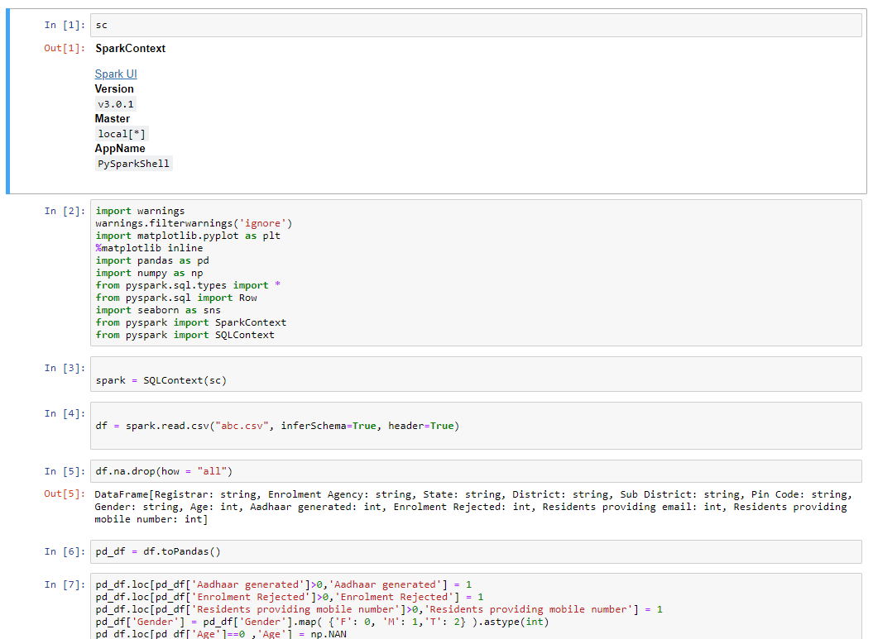
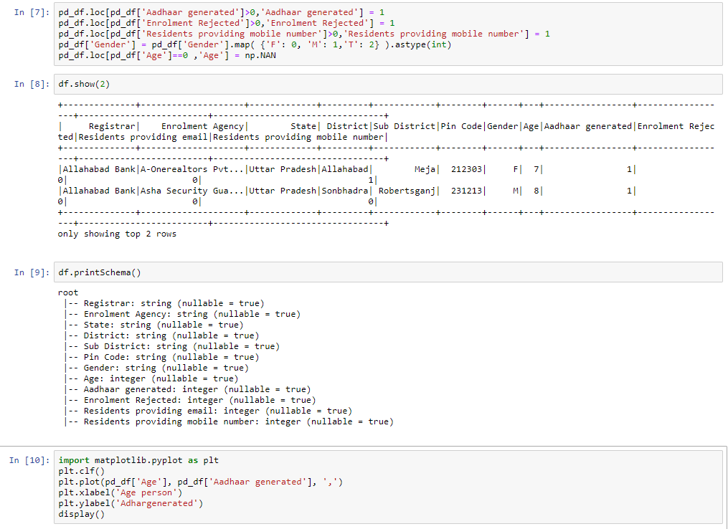
Our code with PySpark

Slide 24
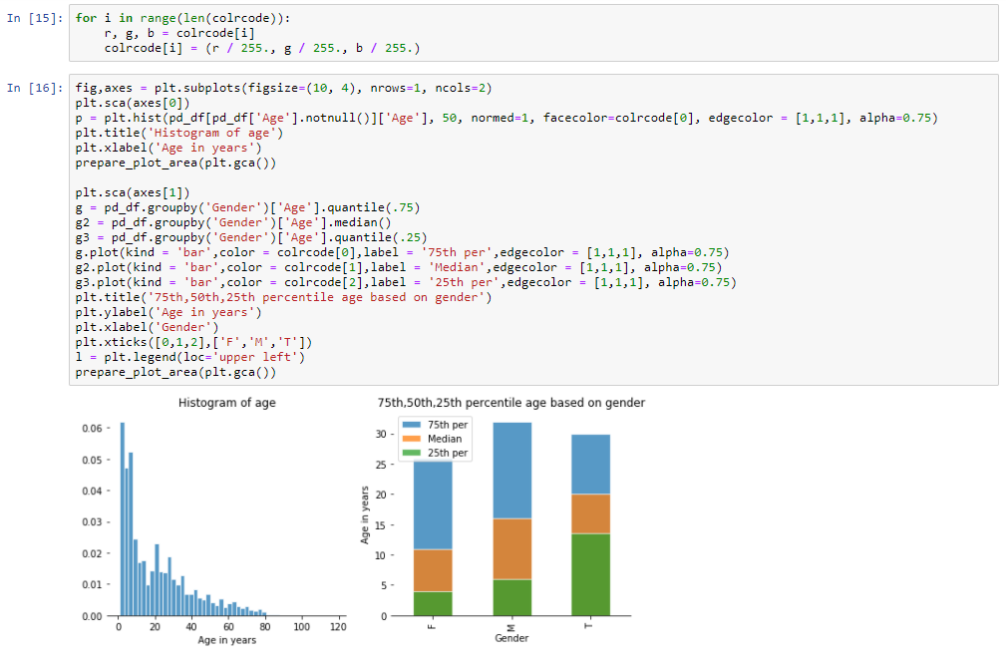
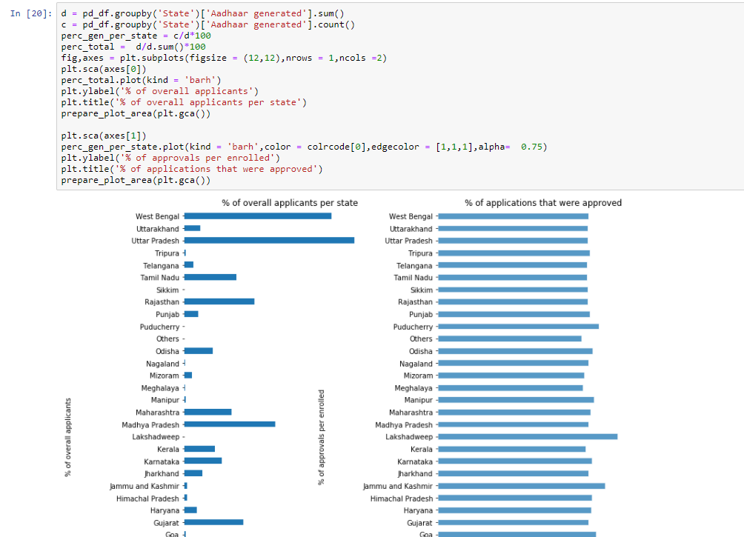
Code

Slide 25
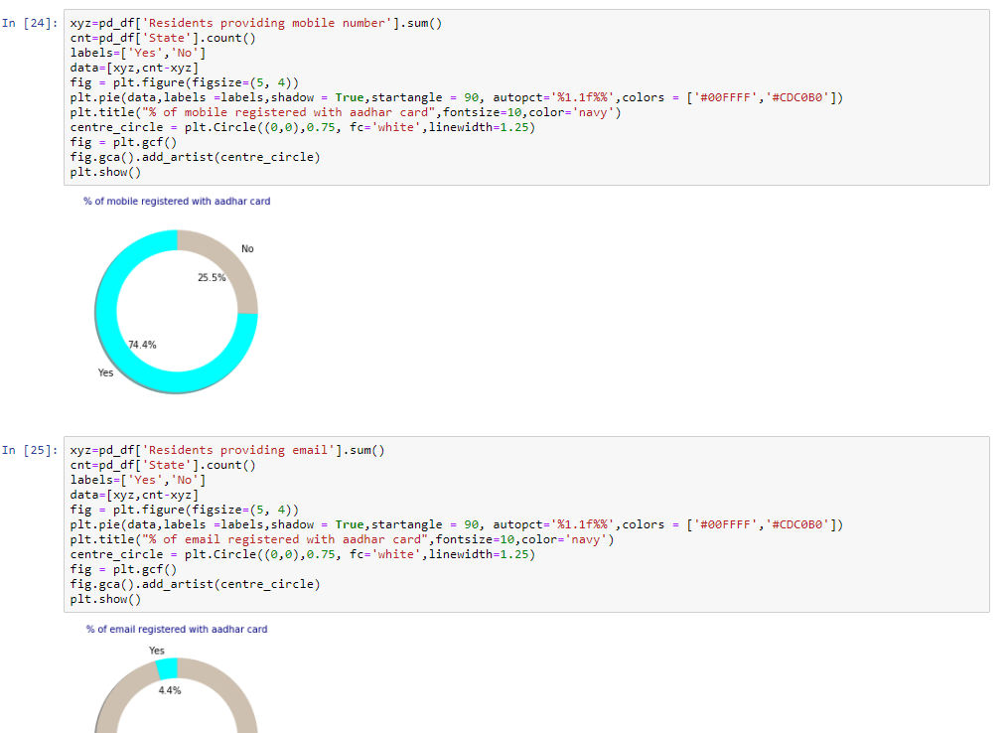
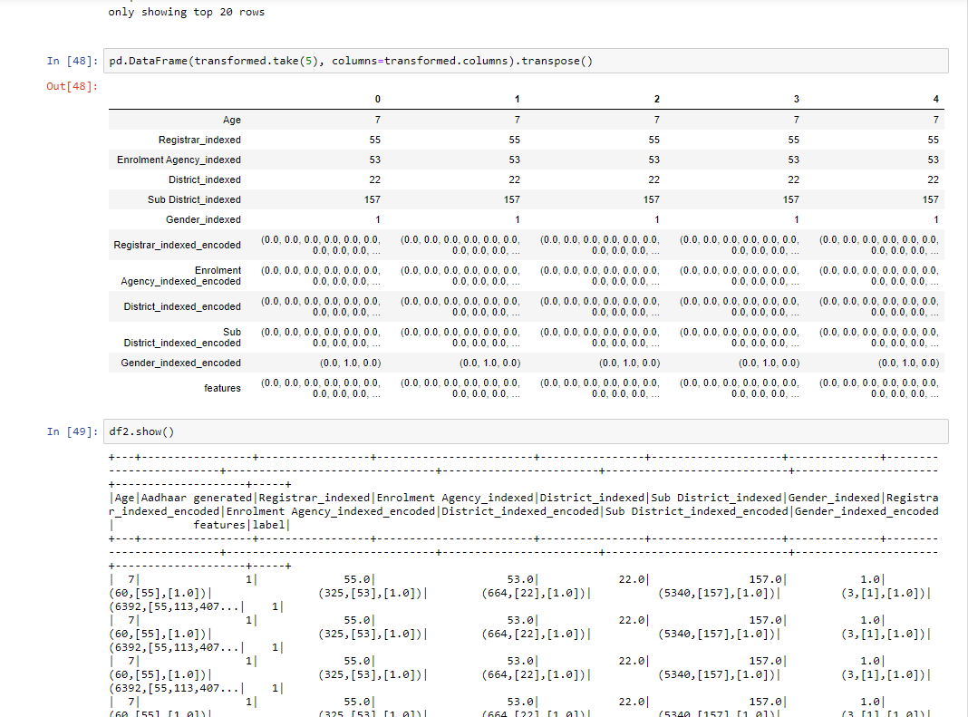
Code

Slide 26
Conclusion
The main reward from this project for us we understand data to create some useful insight with spark framework.
Other than that Our approach towards distributed system is much clear after this project with the large dataset and spark is most relevant framework to handle this type of data to get some useful insights and visualization.
Last but not the least understand many libraries like SQL-Lib for spark, data visualization with spark , data pre processing and create pipeline with spark.

Slide 27
Thank You ☺

